Slide 1

Programming in R and Python
data-action-lab.com

Slide 2
General Learning Objective
Gain hands-on experience with, and a preliminary understanding of, the following elements of code in both R and Python:
Blocks (and Scope)
Functions
Logical (Control) Flow
Libraries/Packages/Modules
Inputs/Outputs
Interpreters/Compilers
Variables
Data Structures
Operators
Statements and Expressions

Slide 3
CONTENTS
R and Python: Background and Comparison
Resources for Programming
Exercises for Hands-on Learning
Optional Exercises and Readings

Slide 4
Personal Learning Objectives
Depending on where you are starting from, reaching the learning objectives for this session within the time frame of the session itself may be ambitious.
Pick a learning objective for yourself for this session that you think is reasonable given your starting point.
You will have time to continue working on the provided exercises during next week’s morning lab hours. You will get a chance to put your programming skills into practice when we begin our afternoon lab sessions in February.

Slide 5
R and Python: Background and Comparison
PROGRAMMING IN R AND PYTHON

Slide 6
A Bit Of History
R:
a successor to “S”
developed by statisticians as a ‘statistical programming language’
built-in data structures and functionality intended to make working with data easier
gained prominence as a free and open source alternative to expensive statistical software
Python:
created in the early 90’s but popularized in the 00’s
intended to be easy to read, easy to understand and easy to learn, relative to other OOLs
has a massive base of open-source modules

Slide 7
Comparison
[for a comprehensive comparison, consult https://www.datacamp.com/community/tutorials/r-or-python-for-data-analysis]
R:
technically object oriented, but this tends to be a bit hidden in practice
lends itself to quick interactive scripting, data exploration
has special built-in notation for statistical models
has a special data type – the data frame – for handling datasets
Python:
object oriented
lends itself to writing structured, pre-designed computer code.
intended to be a general programming language
designed to create code that is easy to read

Slide 8
A Note : Vectorization in Interpreted Languages
High-level interpreted languages are slower than low-level/ compiled languages.
To get around this, these languages will sometimes hand off (behind the scenes) certain types of operations to functions written in lower-level languages (like C).
In order to take advantage of this, the R and Python, communities emphasize a certain programming strategy when using lists/vectors/arrays.
In particular, they avoid cycling through each item of a list, and instead often use special functions that map a chosen function or operation to every item in the list.
This can run counter to habits gained when learning other languages.

Slide 9
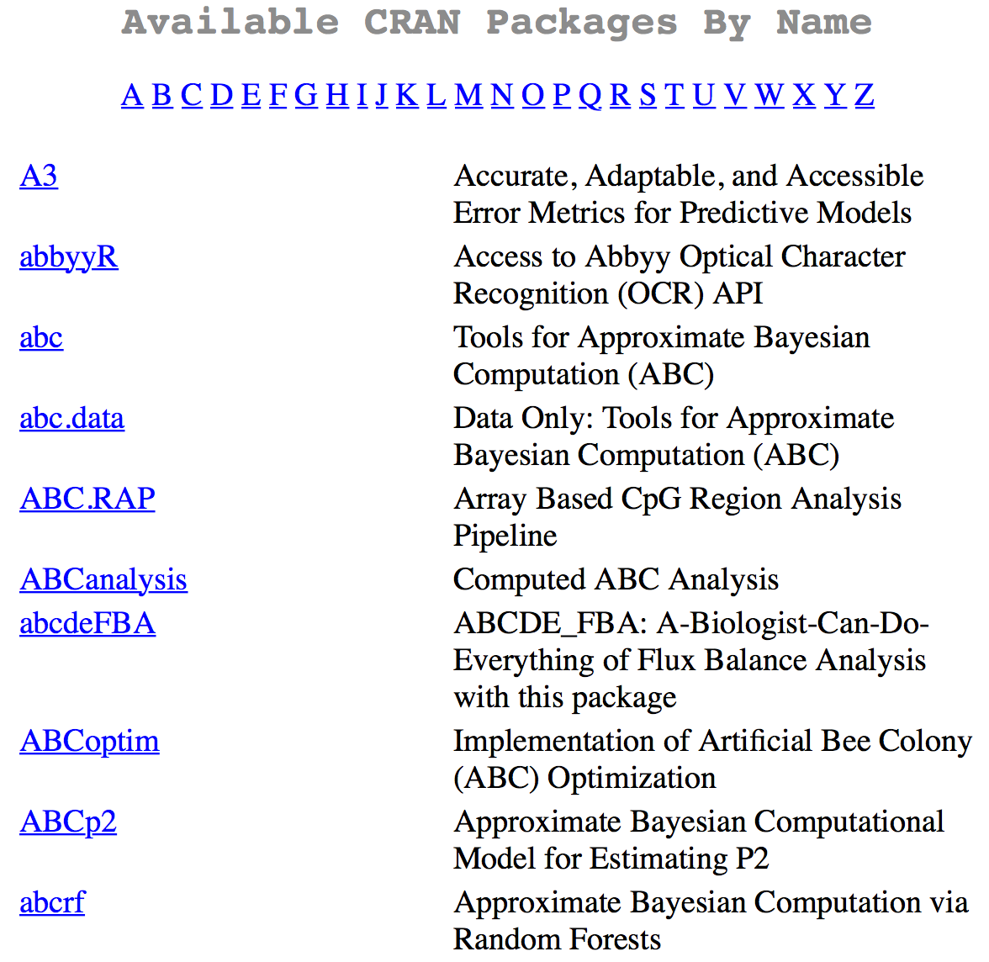
So Many Packages/Modules!
The strength of both R and Python lies in their many technical packages and modules.
These allow a programmer to implement very sophisticated functionality simply by making a few function calls.
Let’s open the RPackagesDemo and PythonPackagesDemo notebooks to see some of this in action.

Slide 10
Resources For Programming
PROGRAMMING IN R AND PYTHON

Slide 11
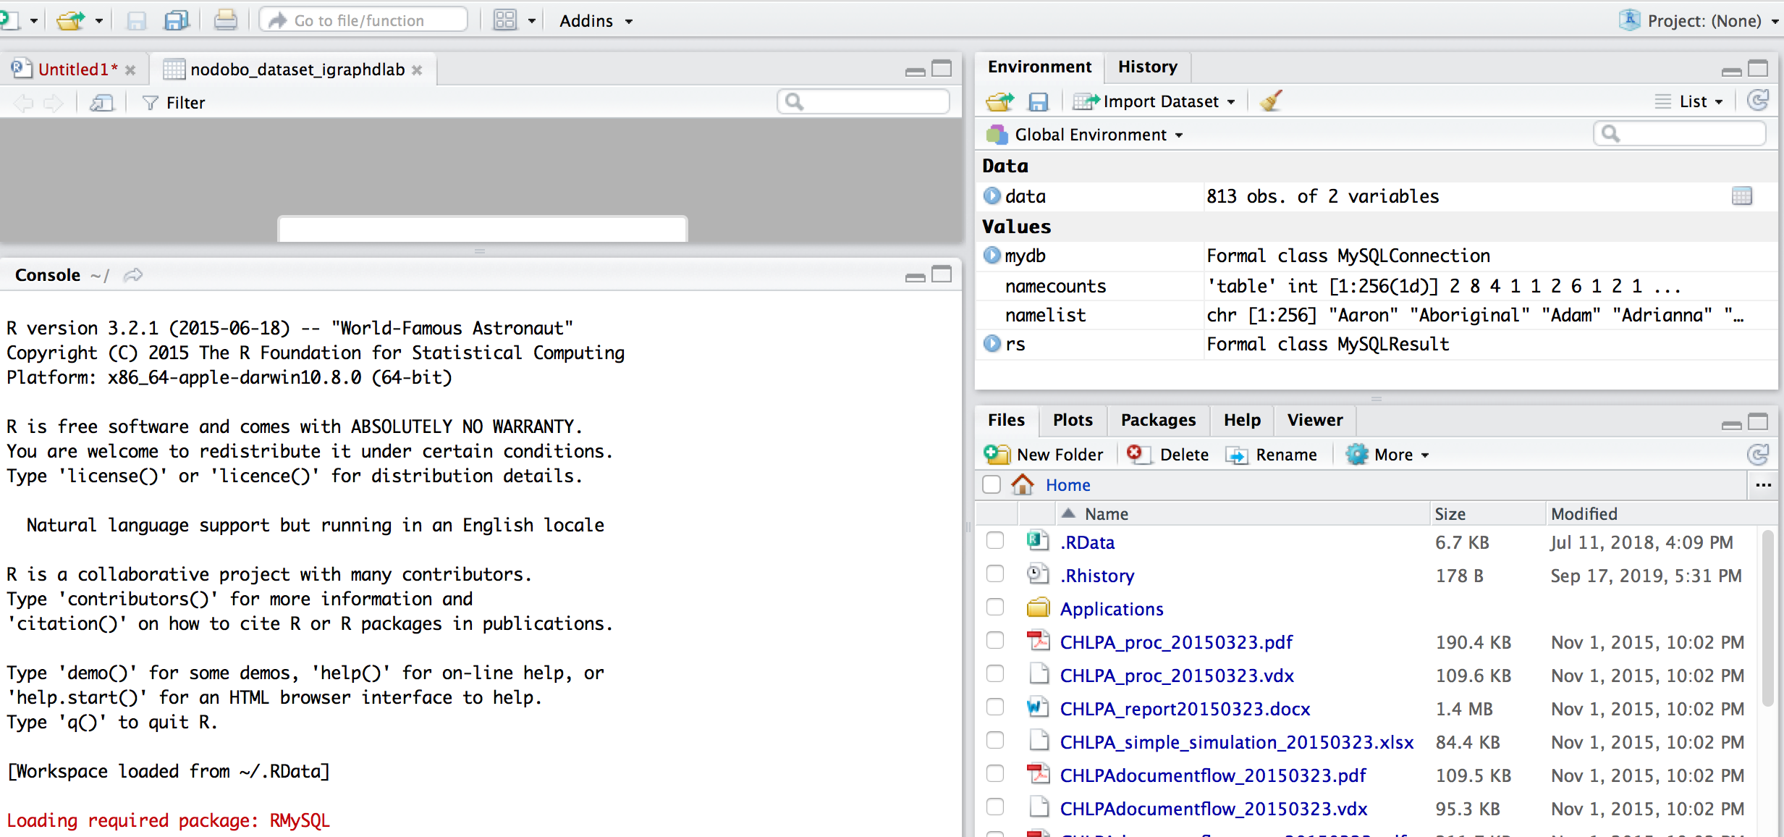
R STudio

Slide 12
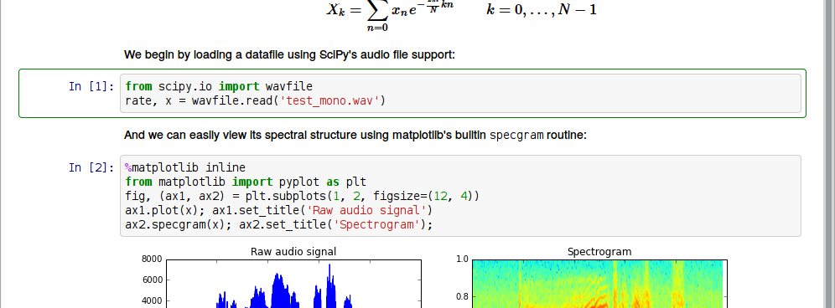
Jupyter Notebooks

Slide 13
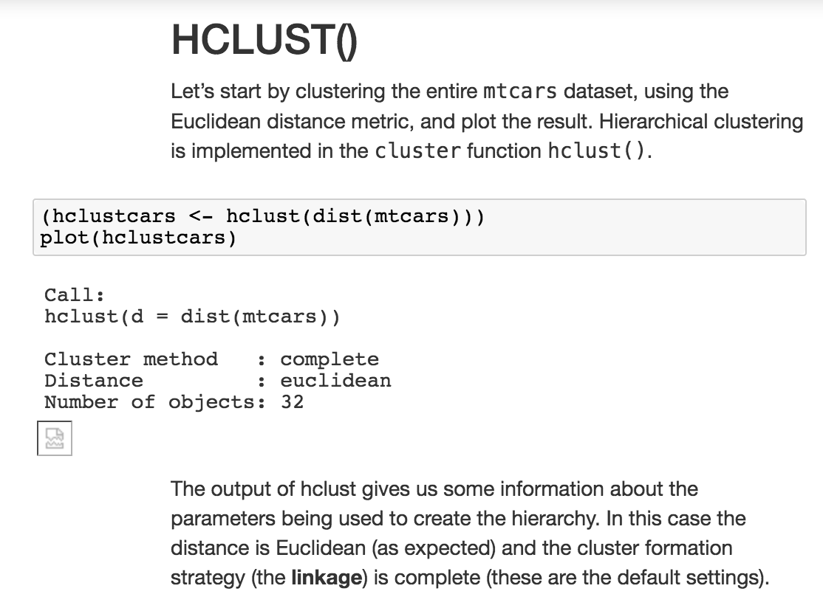
R And Python Notebooks For THIS COURSE
Over the course we will be providing you with many notebooks of sample code.
You can use these notebooks to:
get a sense of what can be done
gain exposure to many examples of the language syntax
help you write your own code
learn why the code works the way it does, and some theory behind the code

Slide 14
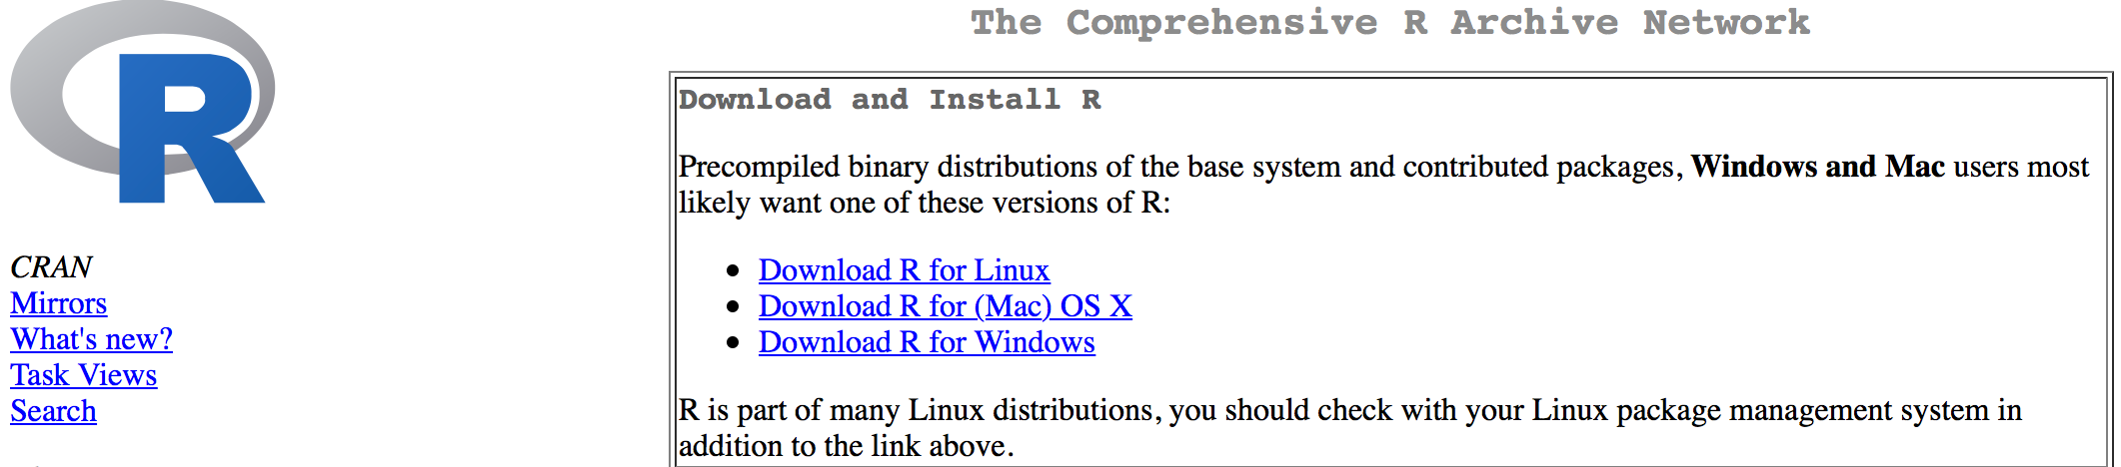
On-Line Resources
Stack Exchange/Stack Overflow/Cross Validated
Blogs (e.g. R Bloggers)
Official Sites:
Python Software Foundation: https://www.python.org
Comprehensive R Archive Network (CRAN): https://cran.r-project.org

Slide 15
Exercises For Hands-On Learning
PROGRAMMING IN R AND PYTHON

Slide 16
Getting Into Programming
Develop or assess R and Python skills by carrying out the following exercises in both R and Python. There is no need to do the exercises in any particular order.
You may choose to carry out each of the exercises separately, or to write a single program that carries out all of the individual exercises.
You will find much of the base code you need in this week’s course notebooks, but you will need to tweak and add to this code to carry out the exercises. You will also find a lot of helpful information and code on the internet!

Slide 17
Expressions, Variables, Data Structures and Operators (1)
Create three variables and assign numerical values to each of these variables.
Then write one or more statements that carry out the following types of operations using these variables: addition, subtraction, multiplication, division, raising to a power.

Slide 18
Expressions, Variables, Data Structures and Operators (2)
Create three variables and assign string values to each of these variables.
Write a statement that joins the three strings into a single string. Write some code that prints the string.
Write some code that tests to see if a substring of your choosing is contained within the larger string.

Slide 19
Expressions, Variables, Data Structures and Operators (3)
Create three variables and assign lists to each of these variables. Join the three lists into a new list containing three distinct sub-lists (a list of three lists).
Create a list without sub-lists (all original list elements are part of a single larger list).
Create a fourth list by splitting this resulting list in half and assigning the second half of the list to a new variable.
Extract the last item of this list (it can either stay in the original list or be removed from it) and assign this element to a variable.

Slide 20
Statements, Blocks, Control Flow, Logical Operators
Write a statement that contains at least three nested blocks.
Use at least three of the following control flow options: if, if else, while, for, break, continue (Python only), next, switch.

Slide 21
Functions
Write a function that takes three arguments as input and returns one value.
Call the function with arguments of your choosing.

Slide 22
Libraries/Packages/Modules
Execute the relevant command that shows a list of the packages (for R) or modules (for Python) that are currently installed in your Jupyter notebook environment.
hint: use the internet, example notebooks and handouts to help you find the relevant command.
Use available documentation to determine what some of these do.
hint: take a look at the Python and R notebooks that are available – you may notice some relevant information there.
choose a module/package from this list and load the relevant package/module if necessary.
Write some code that uses functions and objects supplied by this package.

Slide 23
Inputs/Outputs (1)
Print to the standard output of the Jupyter notebook (in this case, the standard output is the space below a code cell in the notebook that is generated when you run a cell) three sentences of your choosing, on three separate lines, using a single statement of code.

Slide 24
Inputs/Outputs (2)
Locate a comma separated values (CSV) file stored on your computer
(Hint - there should be a folder called Data in the main notebook directory).
Read this file into the notebook and store the results in one or more variables.

Slide 25
Inputs/Outputs (3)
Create a new file and write four lines in CSV format to this file.
In a separate statement, write four more lines to this existing file, without overwriting the original file.

Slide 26
Interpreters/Compilers
Write enough code to generate at least five different error messages from the Jupyter Notebook interpreter.
Copy these error messages into a markdown cell, and write a short note under each explaining the meaning of the error message, and how the code was fixed.

Slide 27
Optional EXERCISES And READINGS
PROGRAMMING IN R AND PYTHON

Slide 28
Optional Exercises
Using a language of your choice, write a function that, when passed a dataset, reports 5 interesting pieces of information about the dataset. Load a dataset and run the function on this dataset.
Using a language of your choice, write two functions. The output of the first function should work as the input to the second function. The first function should read in a dataset and generate a subset of the dataset based on some chosen criteria. The second function should read in a dataset and provide summary data of some type for each column in the dataset. Load a dataset and run both functions on the dataset.

Slide 29
Optional Readings
Best Python Resources: https://www.fullstackpython.com/best-python-resources.html
Top R language resources to improve your data skills: https://www.computerworld.com/article/2497464/business-intelligence/top-r-language-resources-to-improve-your-data-skills.html

